Slide 1
Chapter5 Binary Trees
5.1 Definitions and Properties
5.2 Binary Tree ADT
5.3 Binary Tree Implementations
5.4 Binary Search Trees
5.5 Heaps and Priority Queues
5.6 Huffman Coding Trees
再次复习：
23,24,31,43,46-49,75,82,89,90,99,100,112-120

Slide 2
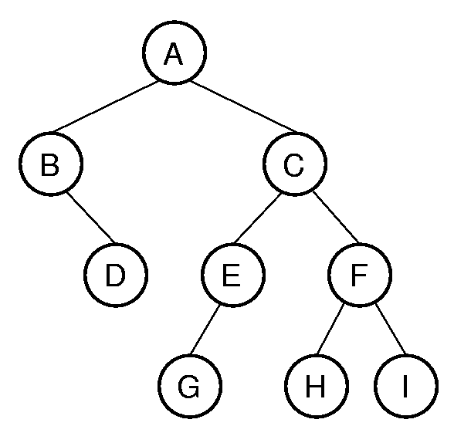
Definition of Binary Tree
A binary tree is made up of a finite set of nodes that is either empty or consists of a node called the root together with two binary trees, called the left and right subtrees, which are disjoint from each other and from the root.
root
Notes:
A has depth 0. B and C from level 1. The tree has height 4. Height = max depth + 1.

Slide 3
Notation
Notation:
root, subtree ,
node, edge,
children, parent,
ancestor, descendant,
path, depth, level, height,
leaf node, internal node.
p141
Notes:
A has depth 0. B and C from level 1. The tree has height 4. Height = max depth + 1.

Slide 4
Binary Tree Example
Check the notations:
root, subtree ,
node, edge,
children, parent,
ancestor, descendant,
path, depth, level, height,
leaf node, internal node.
A
B
C D
E F
G
Notes:
A has depth 0. B and C from level 1. The tree has height 4. Height = max depth + 1.

Slide 5
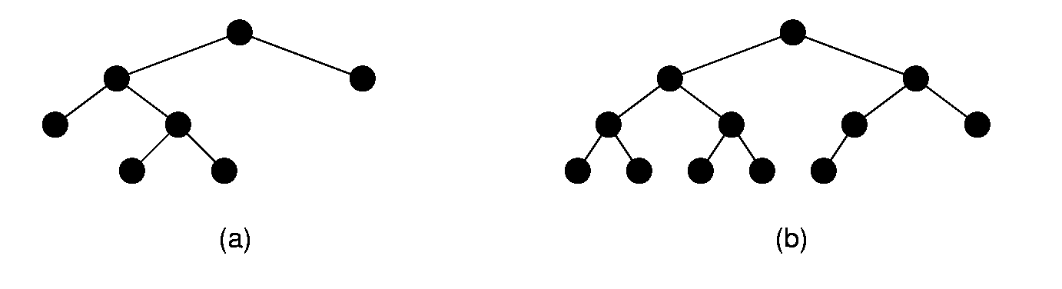
Full Binary Trees
Full binary tree: Each node is either a leaf or internal node with exactly two non-empty children.
Notes:
These terms can be hard to distinguish. Students will need to remember which is which, since this notation will be used several times during the course.

Slide 6
Full Binary Tree Theorem
Theorem1: The number of leaves in a non-empty full binary tree is one more than the number of internal nodes.
Proof: ?
Notes:
This theorem is important, because it helps us to calculate space requirements. It tells us how many nodes are internal and how many are leaf. We need to know this if we have separate implementations for internal and leaf nodes

Slide 7
Complete Binary Trees
Complete binary tree: has a restricted shape obtained by starting at the root and filling the tree by levels from left to right.
If the height of the tree is d, then all levels except possibly level d-1 are completely full. The bottom level has all nodes to the left side.
Notes:
These terms can be hard to distinguish. Students will need to remember which is which, since this notation will be used several times during the course.

Slide 8
Chapter5 Binary Trees
5.1 Definitions and Properties
5.2 Binary Tree ADT
5.3 Binary Tree Implementations
5.4 Binary Search Trees
5.5 Heaps and Priority Queues
5.6 Huffman Coding Trees

Slide 9
Binary Tree Node ADT
Template <class Elem> class BinNode {
public:
virtual Elem& Element( ) =0;
virtual void setElement( const Elem& ) = 0;
virtual BinNode* left( ) const = 0;
virtual void setLeft( BinNode* ) = 0;
virtual BinNode* right( ) const = 0;
virtual void setRight( BinNode* ) = 0;
virtual bool isLeaf( ) = 0;
}

Slide 10
Binary Tree ADT
Template <class Elem> class BinTree {
public:
//get the root of the tree
virtual BinNode<Elem>* getRoot() =0;
//preorder traversal of the subtree rooted at subroot
virtual void preorder(BinNode<Elem>* subroot);
//preorder traversal of the subtree rooted at subroot
virtual void inorder(BinNode<Elem>* subroot);
//preorder traversal of the subtree rooted at subroot
virtual void postorder(BinNode<Elem>* subroot);
}
Any process for visiting the nodes in some order is called a traversal.

Slide 11
Chapter5 Binary Trees
5.1 Definitions and Properties
5.2 Binary Tree ADT
5.3 Binary Tree Implementations
5.3.1 Link-based
5.3.2 Array-based
5.4 Binary Search Trees
5.5 Heaps and Priority Queues
5.6 Huffman Coding Trees

Slide 12
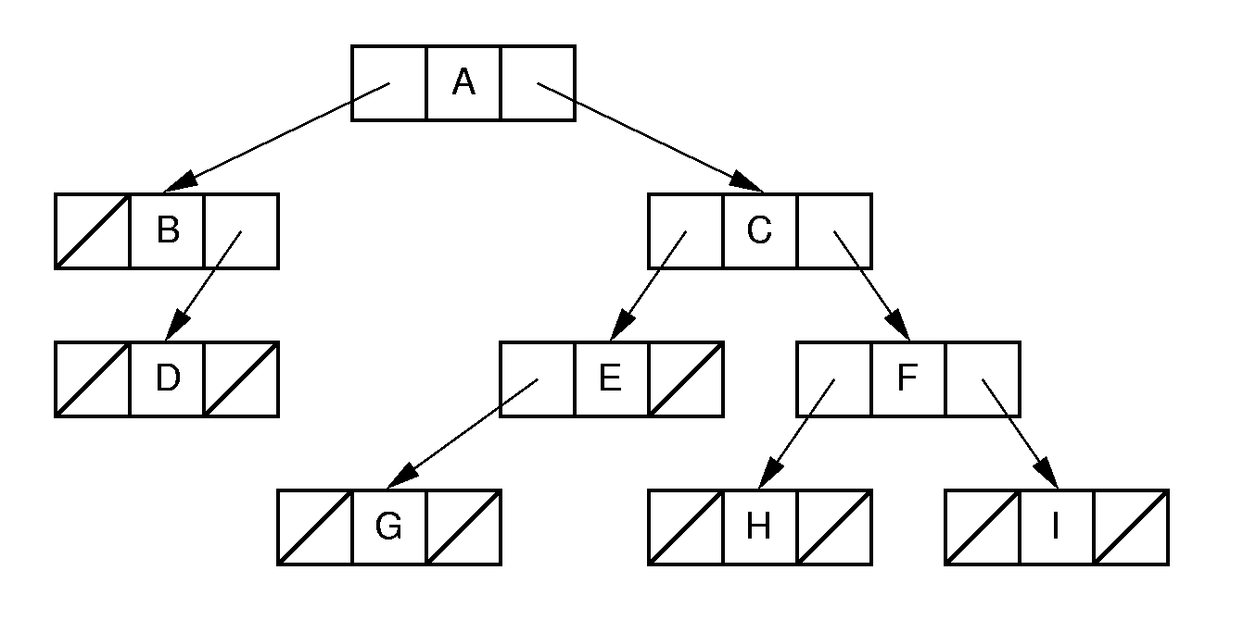
Link-based Binary Tree Implementation
Notes:
Standard implementation (illustrating BinNodePtr class shown earlier). Leaf implementation is identical to internal node implementation, resulting in much wasted space due to null pointers.

Slide 13
Binary Tree Node Class (1)
// Binary tree node class
template <typename Key, typename E>
class BSTNode : public BinNode<E> {
private:
Key k; // The node's key
E it; // The node's value
BSTNode* lc; // Pointer to left child
BSTNode* rc; // Pointer to right child
lc
it
rc

Slide 14
Binary Tree Node Class (2)
public:
BSTNode() { lc = rc = NULL; }
BSTNode(Key K,E e, BSTNode* l =NULL,
BSTNode* r =NULL)
{ k=K; it = e; lc = l; rc = r; }
E& element() { return it; }
void setElement(const E& e) { it = e; }
Key& key() {return k;}
void setKey(const Key& K) {k=K;}
lc
it
rc

Slide 15
Binary Tree Node Class (3)
inline BSTNode* left() const
{ return lc; }
void setLeft(BinNode<E>* b)
{ lc = (BSTNode*)b; }
inline BSTNode* right() const
{ return rc; }
void setRight(BinNode<E>* b)
{ rc = (BSTNode*)b; }
bool isLeaf()
{ return (lc == NULL) && (rc == NULL); }
};
lc
it
rc

Slide 16
Link-based Binary Tree class
class LBinTree:public BinTree <Elem>
{
private:
BinNodePtr<Elem>* root;
public:
BinNode* getRoot() { return root;}
root
lc
it
rc
lc
it
rc
lc
it
rc

Slide 17
Implementation of Traversals (1)
//preorder traversal of the subtree rooted at subroot
void preorder(BinNode<Elem>* subroot);
//preorder traversal of the subtree rooted at subroot
void inorder(BinNode<Elem>* subroot);
//preorder traversal of the subtree rooted at subroot
void postorder(BinNode<Elem>* subroot);
Any process for visiting the nodes in some order is called a traversal.

Slide 18
Implementation of Traversals (2)
Preorder traversal: (先序遍历)
Visit each node before visiting its children
Visit the node-> Preorder traversal of left subtree-> Preorder traversal of right tree
Postorder traversal: (后序遍历)
Visit each node after visiting its children.
Postorder traversal of left subtree-> Postorder traversal of right subtree-> vist the node
Inorder traversal: (中序遍历)
Visit the left subtree, then the node, then the right subtree.
Inorder traversal of the left subtree -> visit the node -> Inorder traversal of the right subtree

Slide 19
Implementation of Traversals (3)
Example:
Preorder traversal:
A B D C E G F H I
Postorder traversal:
D B G E H I F C A
Inorder traversal:
B D A G E C H F I
Exercise:
Postorder traversal: D E C B H G F A
Inorder traversal: B D C E A F H G
What does the tree look like?

Slide 20
Implementation of Traversals (4)
template <class Elem>
void preorder(BinNode<Elem>* subroot) {
if (subroot == NULL) return; // Empty
visit(subroot); // Perform some action
preorder(subroot->left());
preorder(subroot->right());
}
subroot
Notes:
The first implementation is preferred.
The second implementation illustrates a common programming style by many students. It attempts to “look ahead” at the node to be called to determine if it is null or not. This is highly error prone, because the calling function must make sure not to pass in a null pointer for the tree root. It might appear to be more efficient (since it does not make recursive calls on the empty pointers), but it is not in reality since it is checking the pointers twice (to see if not null, then to process them).

Slide 21
Implementation of Traversals (5)
template <class Elem>
void inorder(BinNode<Elem>* subroot) {
if (subroot == NULL) return; // Empty
inorder(subroot->left());
visit(subroot); // Perform some action
inorder(subroot->right());
}
template <class Elem>
void posterorder(BinNode<Elem>* subroot) {
if (subroot == NULL) return; // Empty
postorder(subroot->left());
postorder(subroot->right());
visit(subroot); // Perform some action
}
Notes:
The first implementation is preferred.
The second implementation illustrates a common programming style by many students. It attempts to “look ahead” at the node to be called to determine if it is null or not. This is highly error prone, because the calling function must make sure not to pass in a null pointer for the tree root. It might appear to be more efficient (since it does not make recursive calls on the empty pointers), but it is not in reality since it is checking the pointers twice (to see if not null, then to process them).

Slide 22
Non-recursion Version of Traversal (1)
1
Preorder traversal
1
5
5
1
2
2
null
null
1
2
3
3
4
1
4
null
null
null
null
1
2
1
1
放在栈中的元素表示已经访问过且右子树尚未访问过节点。
在访问该节点的左子树之前，现将该节点入栈。

Slide 23
Non-recursion Version of Traversal (1)
1
Preorder traversal
1
5
5
1
2
2
null
null
1
2
3
3
4
1
4
null
null
null
null
1
2
1
1
放在栈中的元素表示已经访问过且右子树尚未访问过节点。
在访问该节点的左子树之前，现将该节点入栈。

Slide 24
Non-recursion Version of Tranversal (2)
template <class Elem>
void preorder ( BinNode<Elem>* subroot ) {
AStack<Elem> s;
BinNode<Elem> * p = subroot;
while (p | | s.length( ) ) {
if (p) {
//根指针进栈，访问根节点，遍历左子树
visit (p);
s.push (p);
p = p－>left( );
} // if
else { //根指针退栈，访问根结点，遍历右子树
p=s.Pop ();
p = p－>right( );
} // else
} // while
return OK;
} // PreOrderTraverse

Slide 25
Space Overhead (1)
Total space required is (2p + d)n,
(p is the size of a pointer and d is the size of the stored data）
Overhead: 2pn
If p = d, this means (2pn)/((2p + d)n) = 2/3 overhead.
root
lc
it
rc
lc
it
rc
lc
it
rc

Slide 26
Space Overhead (2)
Theorem2: The number of null pointers in a non-empty binary tree is one more than the number of nodes in the tree.
Proof: 2n – (n-1) = n+1
root
lc
it
rc
lc
it
rc
lc
it
rc
NULL
NULL
NULL
NULL

Slide 27
Extension (1)
Add 2 functions to the LBinTree class:
// Return the number of nodes in the subtree
int count(BinNode<Elem>* subroot)
// Return the height of the subtree
int height(BinNode<Elem>* subroot)
How to implement them??

Slide 28
Extension (2)
// Return the number of nodes in the subtree
template <class Elem>
int count(BinNode<Elem>* subroot) {
if (subroot == NULL)
return 0; // Nothing to count
return 1 + count(subroot->left())
+ count(subroot->right());
}
How to implement height(BinNode<Elem>* subroot)?

Slide 29
Chapter5 Binary Trees
5.1 Definitions and Properties
5.2 Binary Tree Traversals
5.3 Binary Tree Implementations
5.3.1 Link-based
5.3.2 Array-based
5.4 Binary Search Trees
5.5 Heaps and Priority Queues
5.6 Huffman Coding Trees

Slide 30
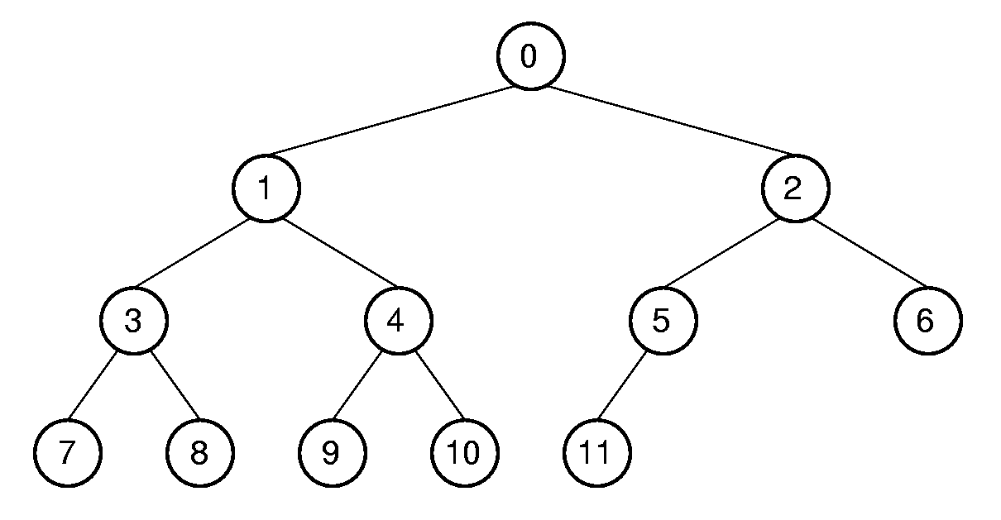
Array based Implementation for complete binary tree(1)
0
1
2
3
4
5
6
7
8
9
10
11
array
Notes:
This is a good example of logical representation vs. physical implementation.
Since the complete binary tree is so limited in its shape (there is only one possible shape for n nodes), it is reasonable to expect that space efficiency can be achieved.

Slide 31
Array-based Implementation for Complete Binary Tree (2)
0
1
2
3
4
5
6
7
8
9
10
11
Parent (r) = ⎣(r - 1) / 2 ⎦ if r ≠ 0 and r < n.
Leftchild(r) = 2r + 1 if 2r+1 < n.
Rightchild(r) = 2r + 2 if 2r +2 < n.
Notes:
Parent(r) = (r-1)/2 if r <> 0 and r < n.
Leftchild(r) = 2r + 1 if 2r + 1 < n.
Rightchild(r) = 2r + 2 if 2r + 2 < n.
Leftsibling(r) = r - 1 if r is even, r > 0, and r < n.
Rightsibling(r) = r + 1 if r is odd and r + 1 < n.

Slide 32
Array-based Implementation for Complete Binary Tree (3)
0
1
2
3
4
5
6
7
8
9
10
11
Leftsibling(r) = r - 1 if r is even, r > 0 and r < n
Rightsibling(r) = r + 1 if r is odd, r +1 < n.
Notes:
Parent(r) = (r-1)/2 if r <> 0 and r < n.
Leftchild(r) = 2r + 1 if 2r + 1 < n.
Rightchild(r) = 2r + 2 if 2r + 2 < n.
Leftsibling(r) = r - 1 if r is even, r > 0, and r < n.
Rightsibling(r) = r + 1 if r is odd and r + 1 < n.

Slide 33
Array based Implementation for complete binary tree(4)
0
1
2
3
4
5
6
7
8
9
10
11
Position | 0 | 1 | 2 | 3 | 4 | 5 | 6 | 7 | 8 | 9 | 10 | 11
Parent | -- | 0 | 0 | 1 | 1 | 2 | 2 | 3 | 3 | 4 | 4 | 5
Left Child | 1 | 3 | 5 | 7 | 9 | 11 | -- | -- | -- | -- | -- | --
Right Child | 2 | 4 | 6 | 8 | 10 | -- | -- | -- | -- | -- | -- | --
Left Sibling | -- | -- | 1 | -- | 3 | -- | 5 | -- | 7 | -- | 9 | --
Right Sibling | -- | 2 | -- | 4 | -- | 6 | -- | 8 | -- | 10 | -- | --
Notes:
This is a good example of logical representation vs. physical implementation.
Since the complete binary tree is so limited in its shape (there is only one possible shape for n nodes), it is reasonable to expect that space efficiency can be achieved.

Slide 34
Array-based Normal Binary Tree
a
b
Leftchild(r) = 2r + 1
Rightchild(r) = 2r + 2
c
d
e
a
b
c
d
e
0
1
2
3
4
5
6
7
8
9
10
How to implement the Binary Tree class?

Slide 35
Chapter5 Binary Trees
5.1 Definitions and Properties
5.2 Binary Tree Traversals
5.3 Binary Tree Implementations
5.3.1 Link-based
5.3.2 Array-based
5.4 Binary Search Trees
5.5 Heaps and Priority Queues
5.6 Huffman Coding Trees

Slide 36
Search in a binary tree
How to Search the node H?
Traversal of the whole tree.
Preorder, inorder, postorder
Any other faster data structure to support search?

Slide 37
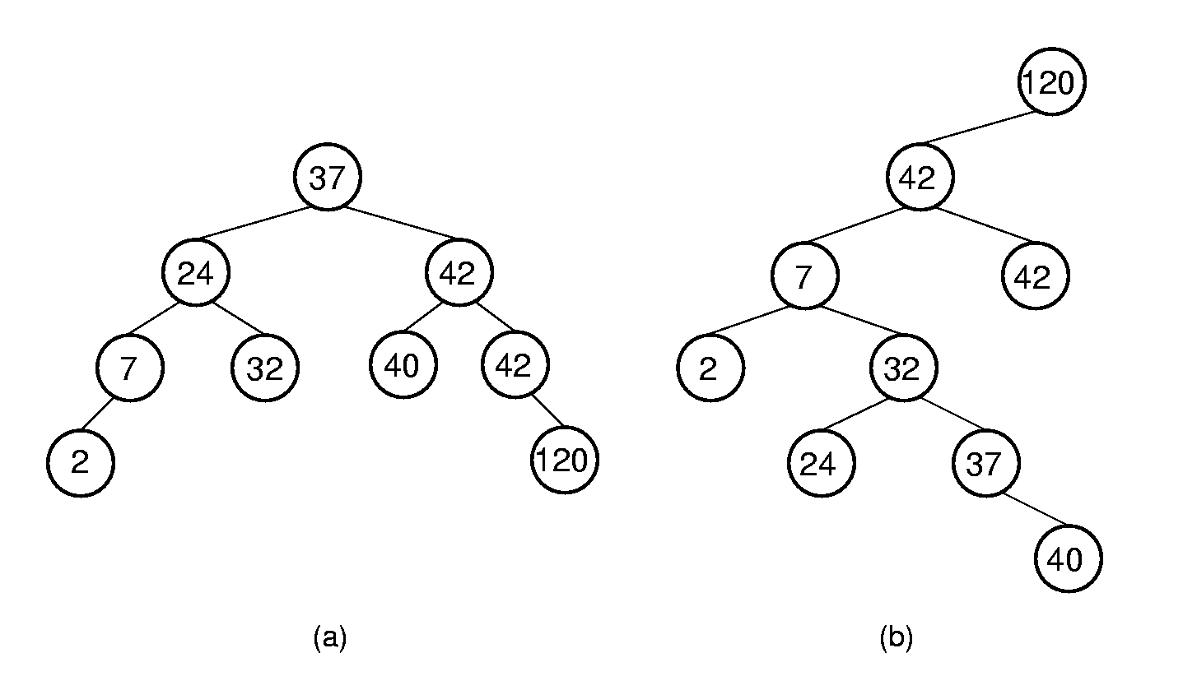
Binary Search Trees (BST)
BST Property: All elements stored in the left subtree of a node with value K have values < K. All elements stored in the right subtree of a node with value K have values >= K.
? How to search in BST
? How many times of nodes comparison
Better than Θ(n)
Notes:
Lists have a major problem: Either insert/delete on the one hand, or search on the other, must be Θ(n) time. How can we make both update and search efficient? Answer: Use a new data structure.

Slide 38
BST class(1)
// BST implementation for the Dictionary ADT
template <typename Key, typename E>
class BST {
private:
BSTNode<Elem>* root; // Root of the BST
int nodecount; // Number of nodes
......
public:
BST() { root = NULL; nodecount = 0; }
~BST() { clearhelp(root); }
root

Slide 39
BST class(2)
clearhelp(BStNode<key, E>* subroot)
{
if(subroot == NULL) return;
clearhelp(subroot->left());
clearhelp(subroot->right());
delete subroot;
}
void clear() { clearhelp(root); root = NULL;
nodecount = 0; }
root

Slide 40
BST Search (1)
E find(const Key& k) const
{ return findhelp(root, k); }
E findhelp(BSTNode<key, E>* root, const Key& k)
{
if (root == NULL) return NULL;
if (k < root->key())
return findhelp(root->left(), k);
else if (k > root->key())
return findhelp(root->right(), k);
else { return root->element; }
}
root
Notes:
NEED TO QUANTIFY THE TIME COMPLEXITY . O(LOGn)

Slide 41
BST Search (2)
Best case:
40
find (40)
37
50
24
42
53
60
Worst case:
60
53
50
40
find (24)
42
40
h=
37
50
37
24
24
42
53
60
Average case in a balanced BST:
Notes:
NEED TO QUANTIFY THE TIME COMPLEXITY . O(LOGn)

Slide 42
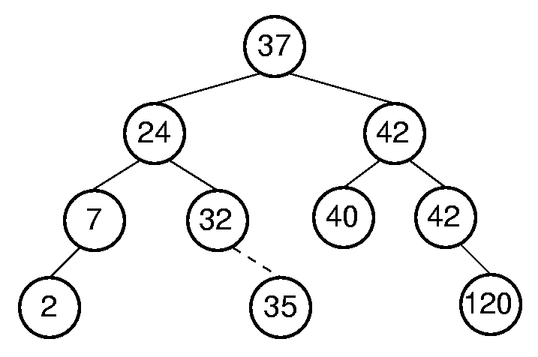
BST Insert (1)
root
Insert 35

Slide 43
BST insert (2)
void insert(const Key& k,const E& e) {
root = inserthelp(root, k,e);
nodecount++;
}
//return the root of the updated BST after insertion
template <typename Key, typename E>
BSTNode<Key,E>* BST<Key, E>::inserthelp(
BSTNode<Key,E>* root, const Key& k, const E& it) {
if (root == NULL) // Empty: create node
return new BSTNode<Key,E>(k,it,NULL,NULL);
if (k < root->key()))
root->setLeft(inserthelp(root->left(),k,it));
else root->setRight(
inserthelp(root->right(), k,it));
// Return subtree with node inserted
return root;
}
root

Slide 44
BST insert (3)
void insert(const Key& k,const E& e) {
root = inserthelp(root, k,e);
nodecount++;
}
//return the root of the updated BST after insertion
template <typename Key, typename E>
BSTNode<Key,E>* BST<Key, E>::inserthelp(
BSTNode<Key,E>* root, const Key& k, const E& it) {
if (root == NULL) // Empty: create node
return new BSTNode<Key,E>(k,it,NULL,NULL);
if (k < root->key()))
root->setLeft(inserthelp(root->left(),k,it));
else root->setRight(
inserthelp(root->right(), k,it));
// Return subtree with node inserted
return root;
}
37
root
37
37
Insert 42
root
Insert 24
42
24
42
24

Slide 45
BST Remove (1)

Slide 46
BST Remove (2)
//return the root of the updated tree after removal
//t point to the removed node
BSTNode<Key,E>* BST<Key, E>::
removehelp(BSTNode<Key,E>* rt, const Key& k) {
if (rt == NULL) return NULL;
else if (k < rt->key())
rt->setLeft(removehelp(rt->left(), k));
else if (k > rt->key())
rt->setRight(
removehelp(subroot->right(), k));
rt

Slide 47
BST Remove (3)
else { // Found it: remove it
BSTNode<Key,E>* temp;
temp = rt;
if (rt->left() == NULL){
rt = rt->right();delete temp; }
else if (rt->right() == NULL){
rt = rt->left();delete temp; }
t
rt
temp
37
delete 37
37
rt
42
42
39
50
39
50

Slide 48
BST Remove (4)
else { // Both children are non-empty
BSTNode<Key,E>* temp;
temp=getmin(rt->right());
rt->setElement(temp->element());
rt->setKey(temp->key());
rt->setRight(
deletemin(subroot->right()));
delete temp;
} }
return rt;
}
rt
37
?
remove 37
30
42
21
32
39
50

Slide 49
BST Remove (4)
else { // Both children are non-empty
BSTNode<Key,E>* temp;
temp=getmin(rt->right());
rt->setElement(temp->element());
rt->setKey(temp->key());
rt->setRight(
deletemin(subroot->right()));
delete temp;
} }
return rt;
}
rt
37
39
remove 37
30
42
21
32
39
39
50
temp

Slide 50
BST Remove (5)
//return the root of the tree after remove the node with the minimum value
BSTNode<Key,E>* BST<Key, E>::
deletemin(BSTNode<Key,E>* rt) {
if (rt->left() == NULL) {
return rt->right();
}
else { // Continue left
rt->setLeft(deletemin(rt->left()));
return rt;
}
}
rt
37
returned value
42
39
50

Slide 51
BST Remove (5)
BSTNode<Key,E>* BST<Key, E>::
deletemin(BSTNode<Key,E>* rt) {
if (rt->left() == NULL) {
return rt->right();
}
else { // Continue left
rt->setLeft(deletemin(rt->left()));
return rt;
}
}
rt
37
returned value
30
42
21
32
39
50

Slide 52
BST Remove (5)
BSTNode<Key,E>* BST<Key, E>::
getmin(BSTNode<Key,E>* rt)
{
if (rt->left() == NULL) return rt;
else
return getmin(rt->left());
}
rt
rt
returned value
37
37
42
30
42
39
50
21
32
39
50
returned value

Slide 53
BST Remove (6)
E remove(const Key& k) {
E temp=findhelp(root,k);
if(temp！=NULL){
root = removehelp(root, k);
nodecount--;
}
return temp;
}

Slide 54
Cost of BST Operations
Find:
Insert:
Delete:
Worst case:
60
53
50
42
40
37
24
40
h=
37
50
24
42
53
60
Average case in a balanced BST:
Notes:
All cost depth of the node in question.
Worst case: θ(n).
Average case: θ(log n).
NEED TO REPEAT.

Slide 55
Exercise
Given a set of elements 17, 28, 54, 30, 27, 94, 15, 21, 83, 40, please construct a Binary Search Tree by inserting the elements to the tree one by one.
Calculate the average number of searches
Notes:
All cost depth of the node in question.
Worst case: θ(n).
Average case: θ(log n).
NEED TO REPEAT.

Slide 56
Exercise
17
17, 28, 54, 30, 27, 94, 15, 21, 83, 40
15
28
27
54
21
30
94
40
83
average number of searches：3.3
Question: average number of searches for sequential search? (10+1)/2=5.5
Notes:
All cost depth of the node in question.
Worst case: θ(n).
Average case: θ(log n).
NEED TO REPEAT.

Slide 57
Chapter5 Binary Trees
5.1 Definitions and Properties
5.2 Binary Tree Traversals
5.3 Binary Tree Implementations
5.3.1 Link-based
5.3.2 Array-based
5.4 Binary Search Trees
5.5 Heaps and Priority Queues
5.6 Huffman Coding Trees

Slide 58
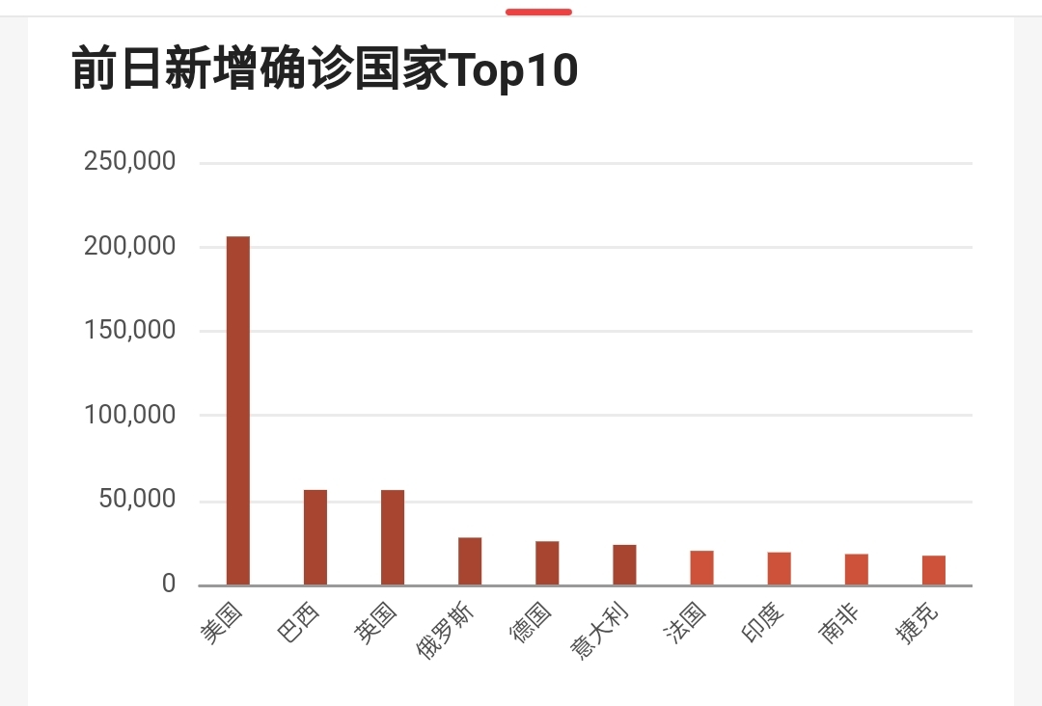
Problem 1
Find the number of people infected with the COVID19. Which are the top five countries?
How to find the maximum/minimum value in a set?

Slide 59

多选题
100分
在一个集合里如何找出最大/最小值？ 逻辑结构？存储结构？算法？
A
线性结构，用数组存储，用遍历方法查找
B
线性结构，用链表存储，用遍历方法查找
C
树，链接存储，用遍历方法查找
D
BST（二叉查找树），链接存储，找最左边的最小的值，或最右边的最大的值
提交

Slide 60
Some solutions
List, traversal
Θ(n)
Tree, traversal
Θ(n)
BST，
Θ(Height)
How to put the maximum and minimum values in an accessible location?
First element of an array, Root of a tree

Slide 61
Problem 2
reading
Breaking news:
Exam tomorrow!
Shopping
with girlfriend
Ping pong
Can this problem be achieved with ordinary queues?
Priority queue！

Slide 62
Heaps
Heap: Complete binary tree with the heap property
Min-heap(小顶堆): every node stores a value that is less than or equal to the value of it children.
Max-heap(大顶堆): every node stores a value that is greater than or equal to the value of it children
12
96
36
24
83
27
85
47
30
53
38
11
09
91
Min-heap
Max-heap
partially ordered

Slide 63
Function of Heaps
?
96
Get the max = 96
83
27
83
27
38
11
09
38
11
09
reorganized into a max-heap
83
Get the max = 83
… …
38
27
09
11
Always keep the maximum/minimum node on the root

Slide 64
Comparison
83
96
11
96
83
27
09
38
38
11
09
27
BST
Max-heap
Shape？
Application？
Efficiency？ BST：？？？ 堆：？？？
Θ(树的高度)

Slide 65
单选题
100分
答案解析
答案解析
答案解析
答案解析
BST和堆分别是解决什么问题的（主要目的）？
A
压缩编码，快速查找特定值
B
快速查找特定值，查找最大/最小值
C
排序，快速查找任一元素
D
索引，压缩编码
提交
可为此题添加文本、图片、公式等解析，且需将内容全部放在本区域内。正常使用需3.0以上版本

Slide 66
How to store the heap？
storage structure of the binary tree
A
B
F
D
E
G
array
A
B
F
D
E
G
Question: What kind of binary tree is suitable for storage in an array?
All binary trees? Full of binary trees? Complete binary tree?

Slide 67
完全二叉树的数组实现
A
r ‘s father= ⎣(r - 1) / 2 ⎦ if r ≠ 0 and r < n.
r ‘s left child= 2r + 1 if 2r+1 < n.
r ‘s right child= 2r + 2 if 2r +2 < n.
r ‘s left brother= r - 1 if r is even, r > 0 and r < n
r ‘s right brother= r + 1 if r is odd, r +1 < n.
B
F
D
E
C
G
H
I
J
K
L
father
r
left child
A
B
F
D
E
C
G
H
I
J
K
L
0
1
2
3
4
5
6
7
8
9
10
11

Slide 68
Implementation of complete tree
A
0
1
2
3
4
5
6
7
8
9
10
11
A
B
F
D
E
C
G
H
I
J
K
L
B
F
D
E
C
G
H
I
J
K
L
Location | 0 | 1 | 2 | 3 | 4 | 5 | 6 | 7 | 8 | 9 | 10 | 11
Father | -- | 0 | 0 | 1 | 1 | 2 | 2 | 3 | 3 | 4 | 4 | 5
Left child | 1 | 3 | 5 | 7 | 9 | 11 | -- | -- | -- | -- | -- | --
Right child | 2 | 4 | 6 | 8 | 10 | -- | -- | -- | -- | -- | -- | --
Left brother | -- | -- | 1 | -- | 3 | -- | 5 | -- | 7 | -- | 9 | --
Right brother | -- | 2 | -- | 4 | -- | 6 | -- | 8 | -- | 10 | -- | --
Whose father？
No. n-1
（Last Node）

Slide 69
Basic Operations
buildHeap
insert
removemax
remove

Slide 70
Heap class (1)
template<class Elem> class maxheap{
private:
Elem* Heap; // Pointer to the heap array
int size; // Maximum size of the heap
int n; // Number of elems now in heap
96
83
27
38
11
9
96
83
27
38
11
9
Heap

Slide 71
Heap class (2)
public:
maxheap(Elem* h, int num, int max)
{Heap = h; n = num; size = max; buildHeap();}
9
27
83
Heap
9
27
83
11
38
96
11
38
96
h
96
buildHeap()
83
27
96
83
27
38
11
9
Heap
38
11
9

Slide 72
Heap class (3)
int heapsize() const{return n;}
bool isLeaf(int pos) const
{return (pos >= n/2)&&(pos < n)};
int leftchild(int pos) const{return 2*pos+1};
int rightchild(int pos) const{return 2*pos+2};
int parent(int pos) const{return (pos-1)/2};
96
83
27
96
83
27
38
11
9
Heap
38
11
9
0 1 2 3 4 5 6 7 8

Slide 73
Heap Insert (1)
Insert 9
Question：
1。Initial position？
2。How to adjust？
7
5
6
4
2
1
7
5
6
4
2
1

Slide 74
Heap Insert (2)
插入 9
7
7
5
6
5
6
Which is father？
⎣(r - 1) / 2 ⎦
4
2
1
9
4
2
1
9
7
5
6
4
2
1
7
5
6
4
2
1
9
9
7
5
7
5
9
4
2
1
6
4
2
1
6
9
5
7
4
2
1
6
7
5
9
4
2
1
6

Slide 75
Insert (3)
bool insert(const Elem& val) {
if (n >= size) return false; // Heap is full
int curr = n++;
Heap[curr] = val; // Start at end of heap
// Now sift up until curr's parent > curr
while ((curr!=0) &&
(Heap[curr] >Heap[parent(curr)])) {
swap(Heap, curr, parent(curr)); //swap curr and its parent
curr = parent(curr);
}
return true;
}
7
cur
5
6
7
5
6
4
2
1
9
cur
Heap
4
2
1
9

Slide 76
Insert (4)
bool insert(const Elem& val) {
if (n >= size) return false; // Heap is full
int curr = n++;
Heap[curr] = val; // Start at end of heap
// Now sift up until curr's parent > curr
while ((curr!=0) &&
(Heap[curr] >Heap[parent(curr)])) {
swap(Heap, curr, parent(curr)); //swap curr and its parent
curr = parent(curr);
}
return true;
}
7
cur
5
9
7
5
9
4
2
1
6
cur
Heap
4
2
1
6

Slide 77
Insert (5)
bool insert(const Elem& val) {
if (n >= size) return false; // Heap is full
int curr = n++;
Heap[curr] = val; // Start at end of heap
// Now sift up until curr's parent > curr
while ((curr!=0) &&
(Heap[curr] >Heap[parent(curr)])) {
swap(Heap, curr, parent(curr)); //swap curr and its parent
curr = parent(curr);
}
return true;
}
9
Θ(log n)
cur
cur
5
7
9
5
7
4
2
1
6
Heap
4
2
1
6

Slide 78
Build a Heap
Call ‘insert’ to insert the element into the heap one by one.
Θ (n logn)
Build a heap by exchanging elements
9
27
83
Heap
9
27
83
11
38
96
11
38
96
96
buildHeap()
83
27
96
83
27
38
11
9
Heap
38
11
9

Slide 79
Building a Heap by Exchanging(1)
By exchanging the positions of the elements
(4-2) (4-1) (2-1) (5-2) (5-4) (7-3) (7-5) (6-5)
Notes:
How to get a good number of exchanges? Induction leads to the following algorithm:
Heapify the root’s subtrees, then push the root to the correct
level.

Slide 80
Building a Heap by Exchanging (2)
(7-3),(5-2), (7-1), (6-1)
More efficient exchanging!
Notes:
How to get a good number of exchanges? Induction leads to the following algorithm:
Heapify the root’s subtrees, then push the root to the correct level.

Slide 81
Bottom-up Building a Heap (1)
Organize the left subtree of the root into a heap.
Organize the right subtree of the root into a heap.
Organize the whole tree into a heap
7
7
1
1
5
6
5
7
5
3
4
2
1
3
4
2
6
3
4
2
6
Max-Heap
Sift (筛选) down

Slide 82
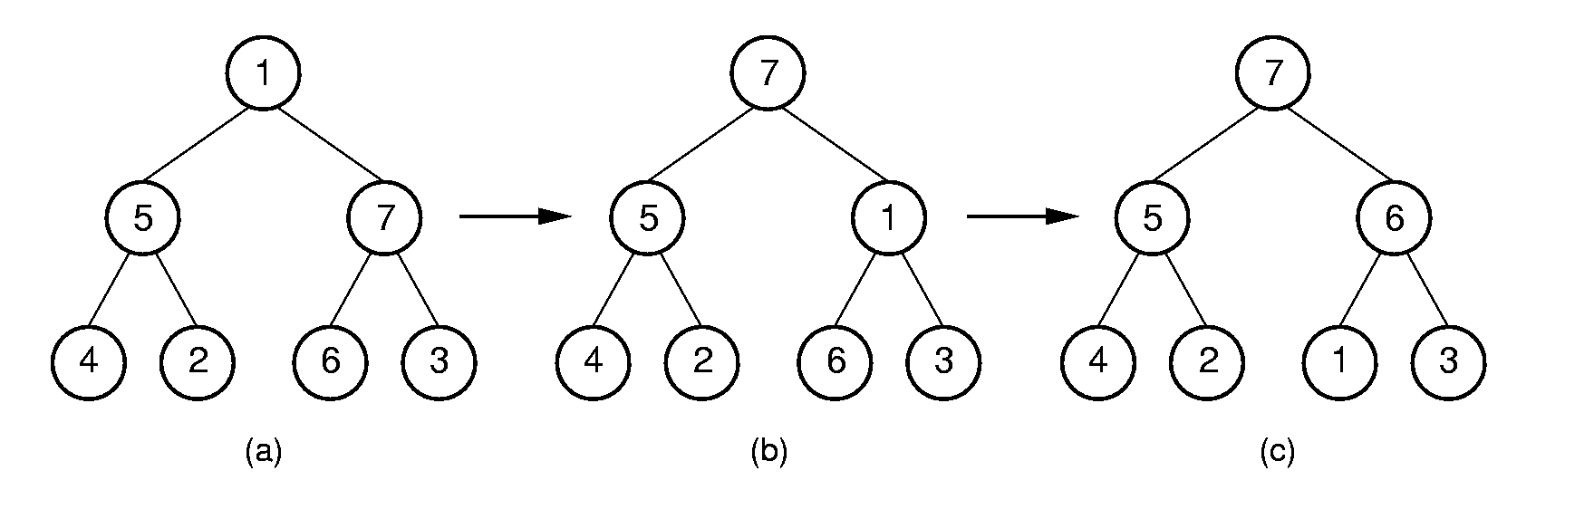
Sift (筛选)down
void siftdown(int pos) {
while (!isLeaf(pos)) {
int j = leftchild(pos);
int rc = rightchild(pos);
if ((rc<n) && Heap[j]< Heap[rc])
j = rc; // j -> the bigger child
if (Heap[pos] >= Heap[j])
return;
swap(Heap, pos, j);
pos = j;
}}
pos
j
rc
pos
pos
j
j

Slide 83
Bottom-up Building a Heap (2)
3
5
6
Work from high end of array to low end.
Call siftdown for each internal node
7
10
30
37
Heap
3
5
6
7
10
30
37
0 1 2 3 4 5 6 7
Siftdown (2)
3
5
37
7
10
30
6
Heap
3
5
37
7
10
30
6
0 1 2 3 4 5 6 7

Slide 84
Bottom-up Building a Heap (2)
3
5
37
Work from high end of array to low end.
Call siftdown for each internal node
7
10
30
6
Heap
3
5
6
7
10
30
37
0 1 2 3 4 5 6 7
Siftdown (1)
3
10
37
7
5
30
6
Heap
3
10
37
7
5
30
6
0 1 2 3 4 5 6 7

Slide 85
Bottom-up Building a Heap (2)
3
10
37
Work from high end of array to low end.
Call siftdown for each internal node
7
5
30
6
Heap
3
5
6
7
10
30
37
0 1 2 3 4 5 6 7
Siftdown (0)
37
37
10
30
10
3
7
5
3
6
7
5
30
6
Heap
37
10
30
7
5
3
6
0 1 2 3 4 5 6 7

Slide 86
Bottom-up Building a Heap (3)
heap construction:
Work from high end of array to low end.
Call siftdown for each internal node
void void buildHeap()
{ for (int i=n/2-1; i>=0; i--) siftdown(i); }
3
The parent of the NO. n - 1 node
5
6
7
10
30
37
Heap
3
5
6
7
10
30
37
0 1 2 3 4 5 6 7

Slide 87
多选题
100分
下面是一个完全二叉树的数组存储，将它调整成大顶堆，下面哪个是正确答案：
3 5 8 31 17 12
A
31 17 12 8 5 3
B
31 17 12 3 8 5
C
31 17 12 5 3 8
D
31 12 17 5 3 8
提交
87

Slide 88
Cost of Buildheap
Cost： log n
∑ (i - 1) n/2^{i} = Θ (n).
i=1
Maximum exchanging frequency
i=4
3×n/16
= (i-1)n/2^{i}
i=3
2×n/8
= (i-1)n/2^{i}
i=2
1×n/4
= (i-1)n/2^{i}
i=1
0
= (i-1)n/2^{i}
Notes:
(i-1) is number of steps down, n/2^{i} is number of nodes at that level.

Slide 89
Remove Max Value
Bool removemax(Elem& it) {
if (n == 0) return false; // Heap is empty
swap(Heap, 0, --n); // Swap max with end
if (n != 0) siftdown(0);
it = Heap[n]; // Return max value
return true;
}
7
3
6
Sift down
5
6
5
6
3
5
4
2
1
3
4
2
1
7
4
2
1
7

Slide 90
bool remove(int pos, Elem& it) {
if ((pos < 0) || (pos >= n)) return false;
swap(Heap, pos, --n);
while ((pos != 0) && (Heap[pos]>
Heap[parent(pos)]))
{ swap(Heap, pos, parent(pos));
pos = parent(pos); }
siftdown(pos);
it = Heap[n];
return true;
}
12
12
pos
11
7
11
7
pos
5
6
9
6
10
8
10
8
4
2
1
3
9
4
2
1
3
5
Notes:
current

Slide 91
bool remove(int pos, Elem& it) {
if ((pos < 0) || (pos >= n)) return false;
swap(Heap, pos, --n);
while ((pos != 0) && (Heap[pos]>
Heap[parent(pos)])))
{ swap(Heap, pos, parent(pos));
pos = parent(pos); }
siftdown(pos);
it = Heap[n];
return true;
}
11
11
pos
pos
7
10
10
3
Sift down
5
6
9
8
5
6
9
8
4
2
1
3
4
2
1
7
Notes:
Current

Slide 92
Application 1 – Priority Queues (1)
Example: Scheduling jobs in a multi-tasking operating system.
job
job
Get the job with
highest priority
to run
job
Priority queues

Slide 93
Application 1 – Priority Queues (2)
Implementation: Use a heap to store the priority queue of the jobs.
job
job
Get the job with
highest priority
to run
job
Organized into a heap by the priority of the jobs

Slide 94
Application 2 –Heap Sort (1)
7
6
delete max
5
6
5
3
4
2
1
3
4
2
1
7
7
5
6
4
2
1
3
6
5
3
4
2
1
7
delete max
4
5
delete max
2
3
3
4
1
5
6
7
1
2
6
7
4
2
3
1
5
6
7
5
4
3
1
2
6
7

Slide 95
Application 2 –Heap Sort (2)
3
2
delete max
2
1
1
3
4
5
6
7
4
5
6
7
3
2
1
4
5
6
7
2
1
3
4
5
6
7
delete max
delete max
4
1
2
3
2
3
1
5
6
7
4
5
6
7
4
2
3
1
5
6
7
1
2
3
4
5
6
7
95

Slide 96
Application 3 –Top K
4
Question:
What is the difference with the sorting problem？
2
3
1
5
6
7
4
2
3
1
5
6
7

Slide 97
Application 4 –Top K in Massive Data
Discussion:
The top k problem of massive data:
In 1.4 billion people, find the richest 1 million people? We need to build a heap of 1.4 billion elements? What is a better way?
1.4 billion
Chinese

Slide 98
Application 4 –Top K in Massive Data
Discussion:
The top k problem of massive data:
In 1.4 billion people, find the richest 1 million people? We need to build a heap of 1.4 billion elements? What is a better way?
1.4 billion
Chinese
1 million
heap with 1 million: Θ（nlogK）, n=1.4 billion，K=1 million
heap with 1.4 billion: Θ（???）
using a list: Θ（???）

Slide 99

Application 4 –Merge(1)
Merge: merged K sorted lists into one
n is the total number of people, and K is the number of ordered lists.

Slide 100
Application 4 –Merge(2)
Strategy:
Step 1: Take the first one in each sorted list and build a Min-heap;
Step 2: Remove the top element of the heap;
Step 3: Remove one (if any) from the top element of this heap, put it on the top of the heap; sift down and adjust it into a heap; go back to the second step.
Θ（nlogK）, n is the total number of people, and K is the number of ordered lists.
if building a heap for all of them, Θ（???）

Slide 101
Coding
Coding: represent a set of items by assigning a unique code to each item.
Fixed-length coding: Each item is represented as a fixed length code.
ASCII codes: 8 bits per character
0100 0001 A 0100 0010 B 0100 0011 C 0100 0100 D 0100 0101 E 0100 0110 F … …
Hello, I am Jimmy.
0100 1000 0110 0101 0110 1100 0110 1100 0110 1111 … …

Slide 102
Different Frequency of characters
Letter | Freq |  | Letter | Freq |  | Letter | Freq
A | 77 |  | J | 4 |  | S | 67
B | 17 |  | K | 7 |  | T | 85
C | 32 |  | L | 42 |  | U | 37
D | 42 |  | M | 24 |  | V | 12
E | 120 |  | N | 67 |  | W | 22
F | 24 |  | O | 67 |  | X | 4
G | 17 |  | P | 20 |  | Y | 22
H | 50 |  | Q | 5 |  | Z | 2
I | 76 |  | R | 59
Hello, I am Jimmy.
How to make the code short?
0100 1000 0110 0101 0110 1100 0110 1100 0110 1111 … …

Slide 103
Variable-length coding
The length of code depends on the frequency of the letters.
Short code for frequently appeared letters.
Letter | Freq | Code
C | 32 | 1110
D | 42 | 101
E | 120 | 0
M | 24 | 11111
K | 7 | 111101
L | 42 | 110
U | 37 | 100
Z | 2 | 111100
Save space cost compared to fix-length coding

Slide 104
Haffman Codes
Huffman coding:
A kind of Variable-length coding
Short code for frequently appeared letters.
Huffman coding is derived from Huffman Tree – a kind of full binary tree

Slide 105
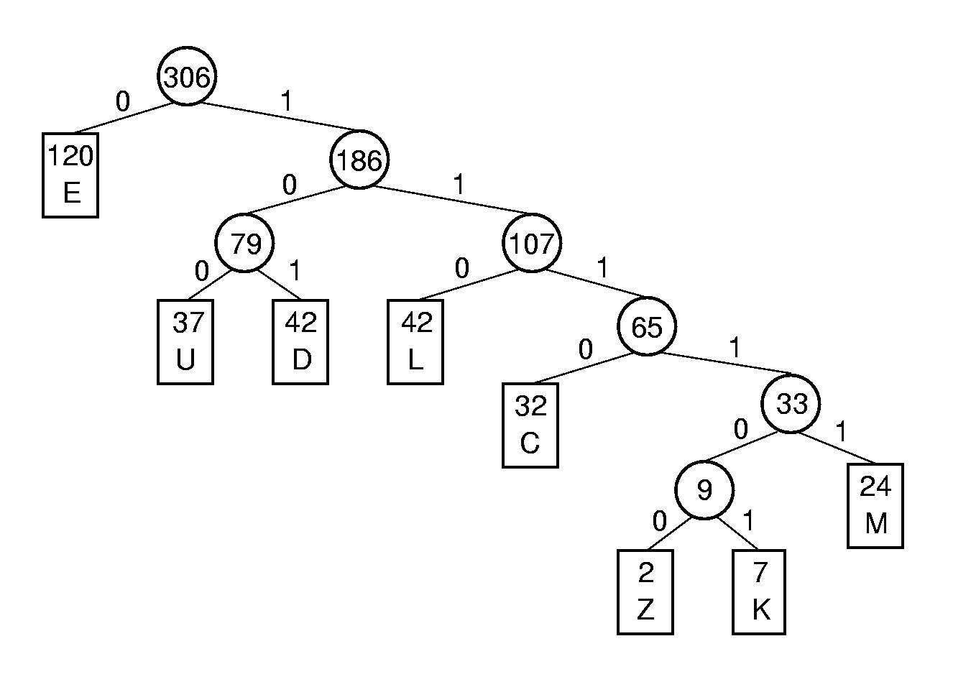
Haffman Tree
Letter | Freq | HuffmanCode
C | 32 | 1110
D | 42 | 101
E | 120 | 0
M | 24 | 11111
K | 7 | 111101
L | 42 | 110
U | 37 | 100
Z | 2 | 111100
Huffman tree: with all the letters as
Leaves and the frequency as
corresponding weight.
Notes:
C: 1110
D: 101
E: 0
F: 1111
K: 111101
L: 110
U: 100
Z: 111100

Slide 106
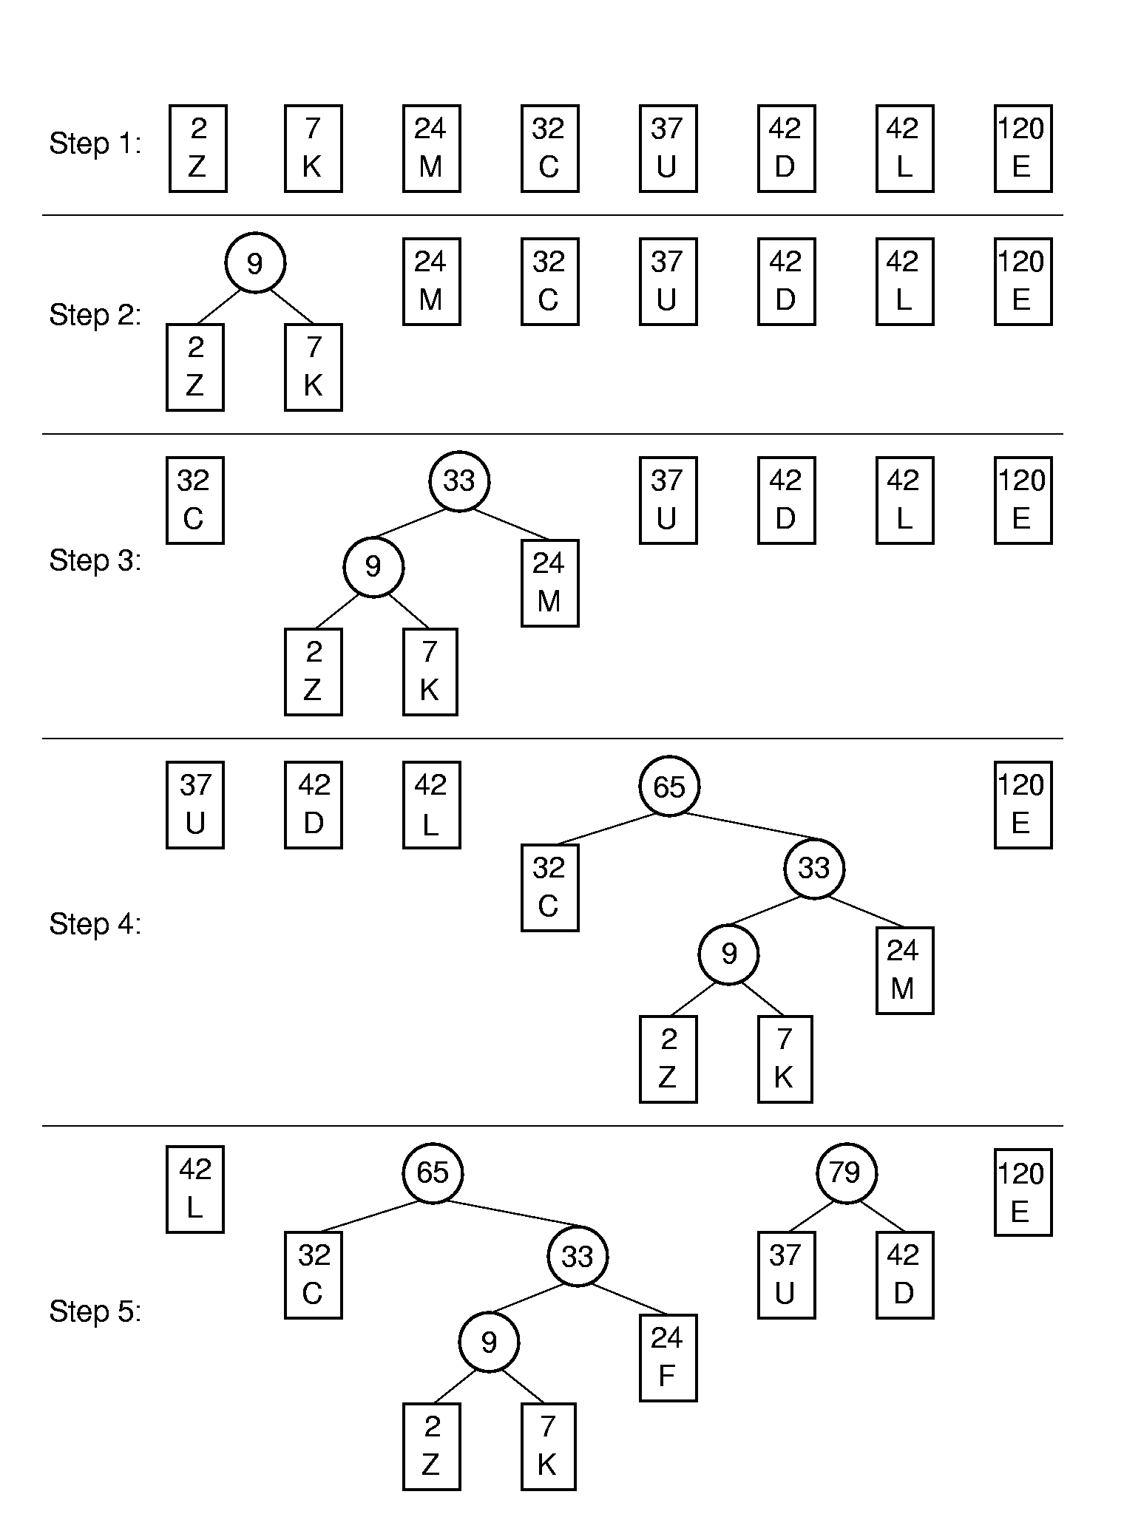
Huffman Tree Construction (1)
Greedy (贪心)

Slide 107
Huffman Tree Construction (2)

Slide 108
Assigning Codes
Letter | Freq | Code
C | 32 | 1110
D | 42 | 101
E | 120 | 0
M | 24 | 11111
K | 7 | 111101
L | 42 | 110
U | 37 | 100
Z | 2 | 111100
Notes:
C: 1110
D: 101
E: 0
F: 1111
K: 111101
L: 110
U: 100
Z: 111100

Slide 109
Cost
Letter | Freq | Code | Bits
C | 32 | 1110 | 4
D | 42 | 101 | 3
E | 120 | 0 | 1
M | 24 | 11111 | 5
K | 7 | 111101 | 6
L | 42 | 110 | 3
U | 37 | 100 | 3
Z | 2 | 111100 | 6
Expected cost per letter:
(4×32+3×42+1×120+5×24+6×7+
3×42+3×37+6×2) / 306 = 785/306 = 2.57
Compared with the fixed length coding:
log₂8 = 3.

Slide 110
Cost (2)
Letter | Freq | Code | Bits
C | 32 | 1110 | 4
D | 42 | 101 | 3
E | 120 | 0 | 1
M | 24 | 11111 | 5
K | 7 | 111101 | 6
L | 42 | 110 | 3
U | 37 | 100 | 3
Z | 2 | 111100 | 6
Expected cost per letter:
(4×32+3×42+1×120+5×24+6×7+
3×42+3×37+6×2) / 306
The cost is decided by the sum of weighted path lengths of all leaves.

Slide 111
Efficiency analysis
Theorem: For the given set of letters, the Huffman tree has the minimum sum of weighted path lengths
That means the cost of the Huffman code is minimum. (optimal prefix-free coding)

Slide 112
Huffman Tree Node class (1)
template <class Elem>
class HuffNode { //Node abstract base class
public:
virtual int weight() = 0;
virtual bool isLeaf() = 0;
virtual HuffNode* left() const = 0;
virtual void setLeft(HuffNode*) = 0;
virtual HuffNode* right() const = 0;
virtual void setRight(HuffNode*) = 0;
};

Slide 113
Huffman Tree Node class (2)
template <class Elem> //leaf node subclass
class LeafNode: public HuffNode<Elem> {
private:
Freqpair<Elem>* it; //Frequency pair
public:
LeafNode(const Elem& val, int freq) //constructor
{ it = new Freqpair<Elem>(val,freq); }
int weight() { return it->weight(); } //Return frequency
Freqpair<Elem>* val() { return it; }
bool isLeaf() { return true; }
virtual HuffNode* left() const { return NULL; }
virtual void setLeft(HuffNode*) { }
virtual HuffNode* right() const { return NULL; }
virtual void setRight(HuffNode*) { } };

Slide 114
Huffman Tree Node class (4)
template <class Elem>
class FreqPair { //An element / frequency pair
private:
Elem it; //An element of some sort
int freq;
public:
FreqPair(const Elem& e, int f) //Constructor
{ it = e; freq = f; }
~FreqPair() { } //Destructor
int weight() { return freq; } //Return the weight
Elem& val() { return it; } //Return the element
};

Slide 115
Huffman Tree Node class (5)
template <class Elem> //Internal node subclass
class IntlNode: public HuffNode<Elem> {
private:
HuffNode<Elem>* lc; //left child
HuffNode<Elem>* rc; //right child
int wgt; //Subtree weight
public:
IntlNode(HuffNode<Elem> * l, HuffNode<Elem> * r)
{ wgt = l->weight() + r->weight(); lc = l; rc = r; }
int weight() { return wgt; } //Return frequency

Slide 116
Huffman Tree Node class (6)
bool isLeaf() { return false; }
HuffNode<Elem>* left() const { return lc; }
void setLeft(HuffNode<Elem>* b)
{ lc = (HuffNode*)b; }
HuffNode<Elem>* right() const { return rc; }
void setRight(HuffNode<Elem>* b)
{ rc = (HuffNode*)b; }
};

Slide 117
Huffman Coding Trees class
template <class Elem>
class HuffTree {
private:
HuffNode<Elem>* theRoot;
public:
HuffTree(Elem& val, int freq)
{ theRoot = new LeafNode<Elem>(val,freq); }
HuffTree(HuffTree<Elem>* l, HuffTree<Elem>* r)
{ theRoot = new IntlNode<Elem>(l->root(), r->root()); }
~ HuffTree() { }
HuffNode<Elem>* root() { return theRoot; }
int weight() { return theRoot->weight(); }
};
theRoot

Slide 118
Sorted Link List(1)
//compare the weight of the roots of two Huffman Trees
template <class Elem> class HHCompare {
public:
static bool lt(HuffTree<Elem>* x, HuffTree<Elem>* y)
{ return x->weight() < y->weight(); }
static bool eq(HuffTree<Elem>* x, HuffTree<Elem>* y)
{ return x->weight() = = y->weight(); }
static bool gt(HuffTree<Elem>* x, HuffTree<Elem>* y)
{ return x->weight() > y->weight(); }
};

Slide 119
Sorted Link List (2)
//sorted link list
template <class Elem, class Compare>
class SLList: protected LList<Elem> {
public:
SLList(int size=DefaultListSize) : LList<Elem>(size) {}
~SLList() {} // Destructor
bool insert(const Elem& item) { // Insert at right
Elem curr;
for (setStart(); getValue(curr); next())
if(!Compare::lt(curr, item)) break;
return LList<Elem>::insert(item);
}
… …

Slide 120
Build Huffman Tree
template <class Elem> HuffTree<Elem>*
buildHuff(SLList <HuffTree<Elem>*,HHCompare<Elem> >* f1) {
HuffTree<Elem>* temp1, *temp2, *temp3;
for (f1->setStart(); f1->leftLength()+f1->rightLength()>1;
f1->setStart()) { //While at least two items left
f1->remove(temp1); //Pull first two trees off the list
f1->remove(temp2);
temp3 = new HuffTree<Elem>(temp1, temp2);
f1->insert(temp3); //Put the new tree back on list
delete temp1; //Must delete the remnants
delete temp2; // of the trees we created
}
return temp3; }

